Slide 1

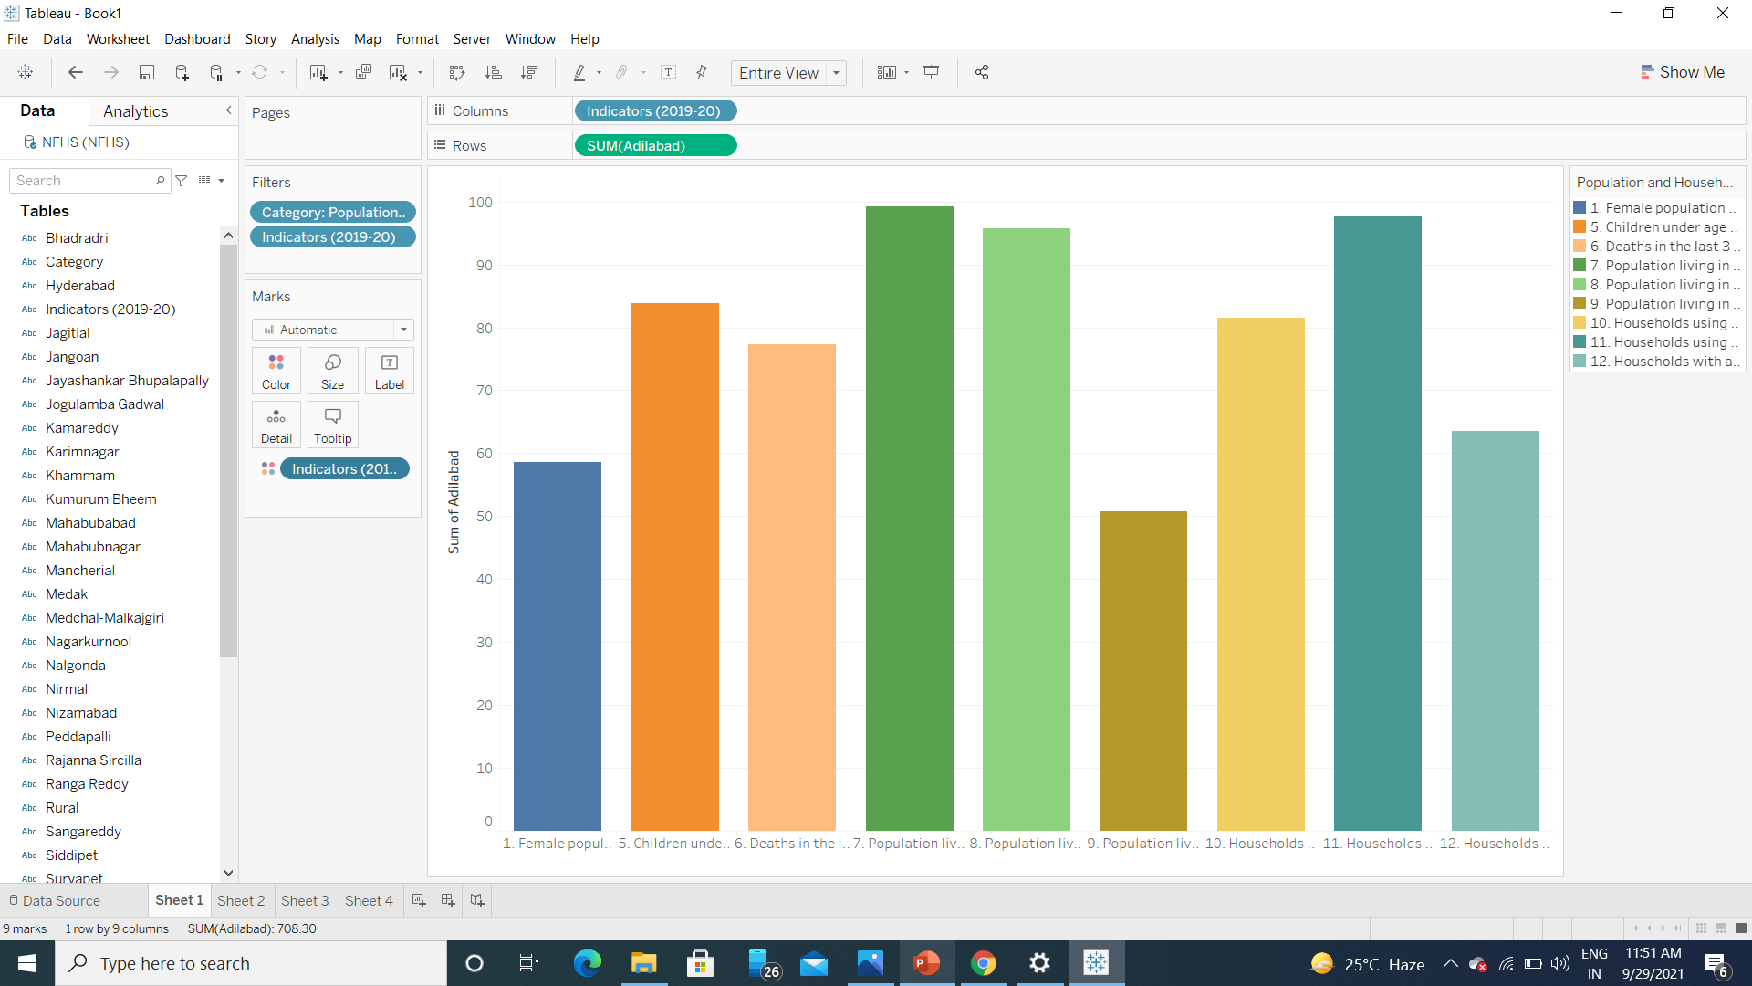
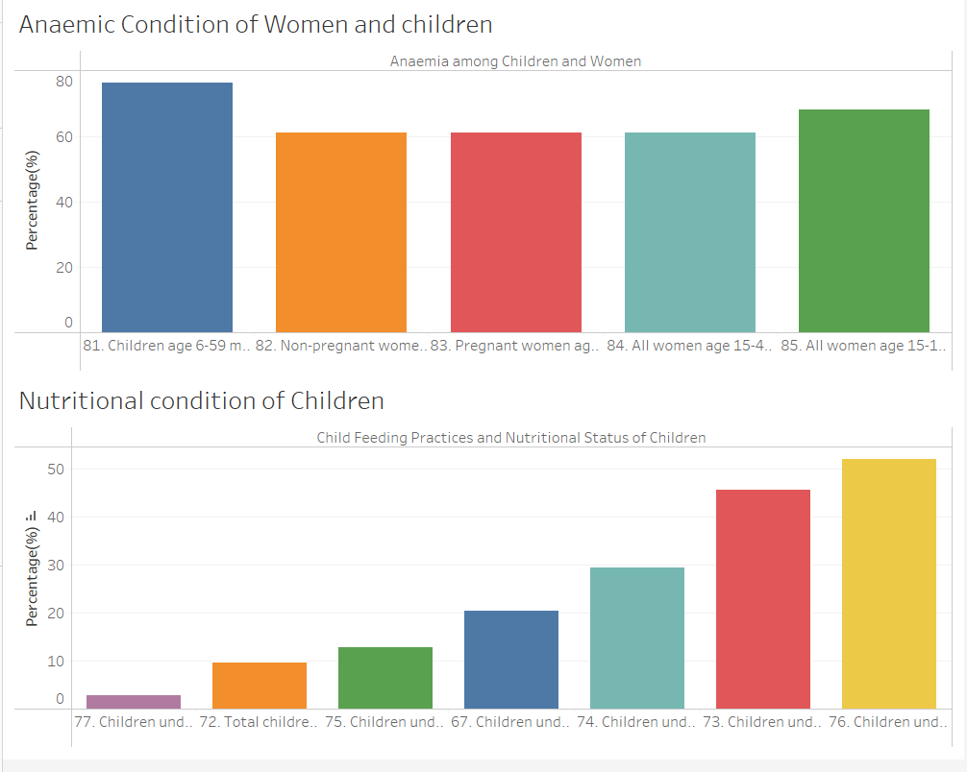
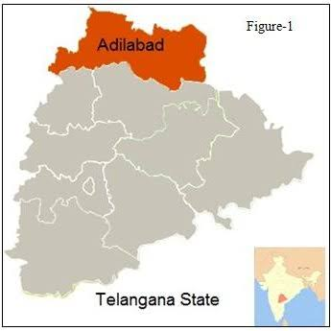
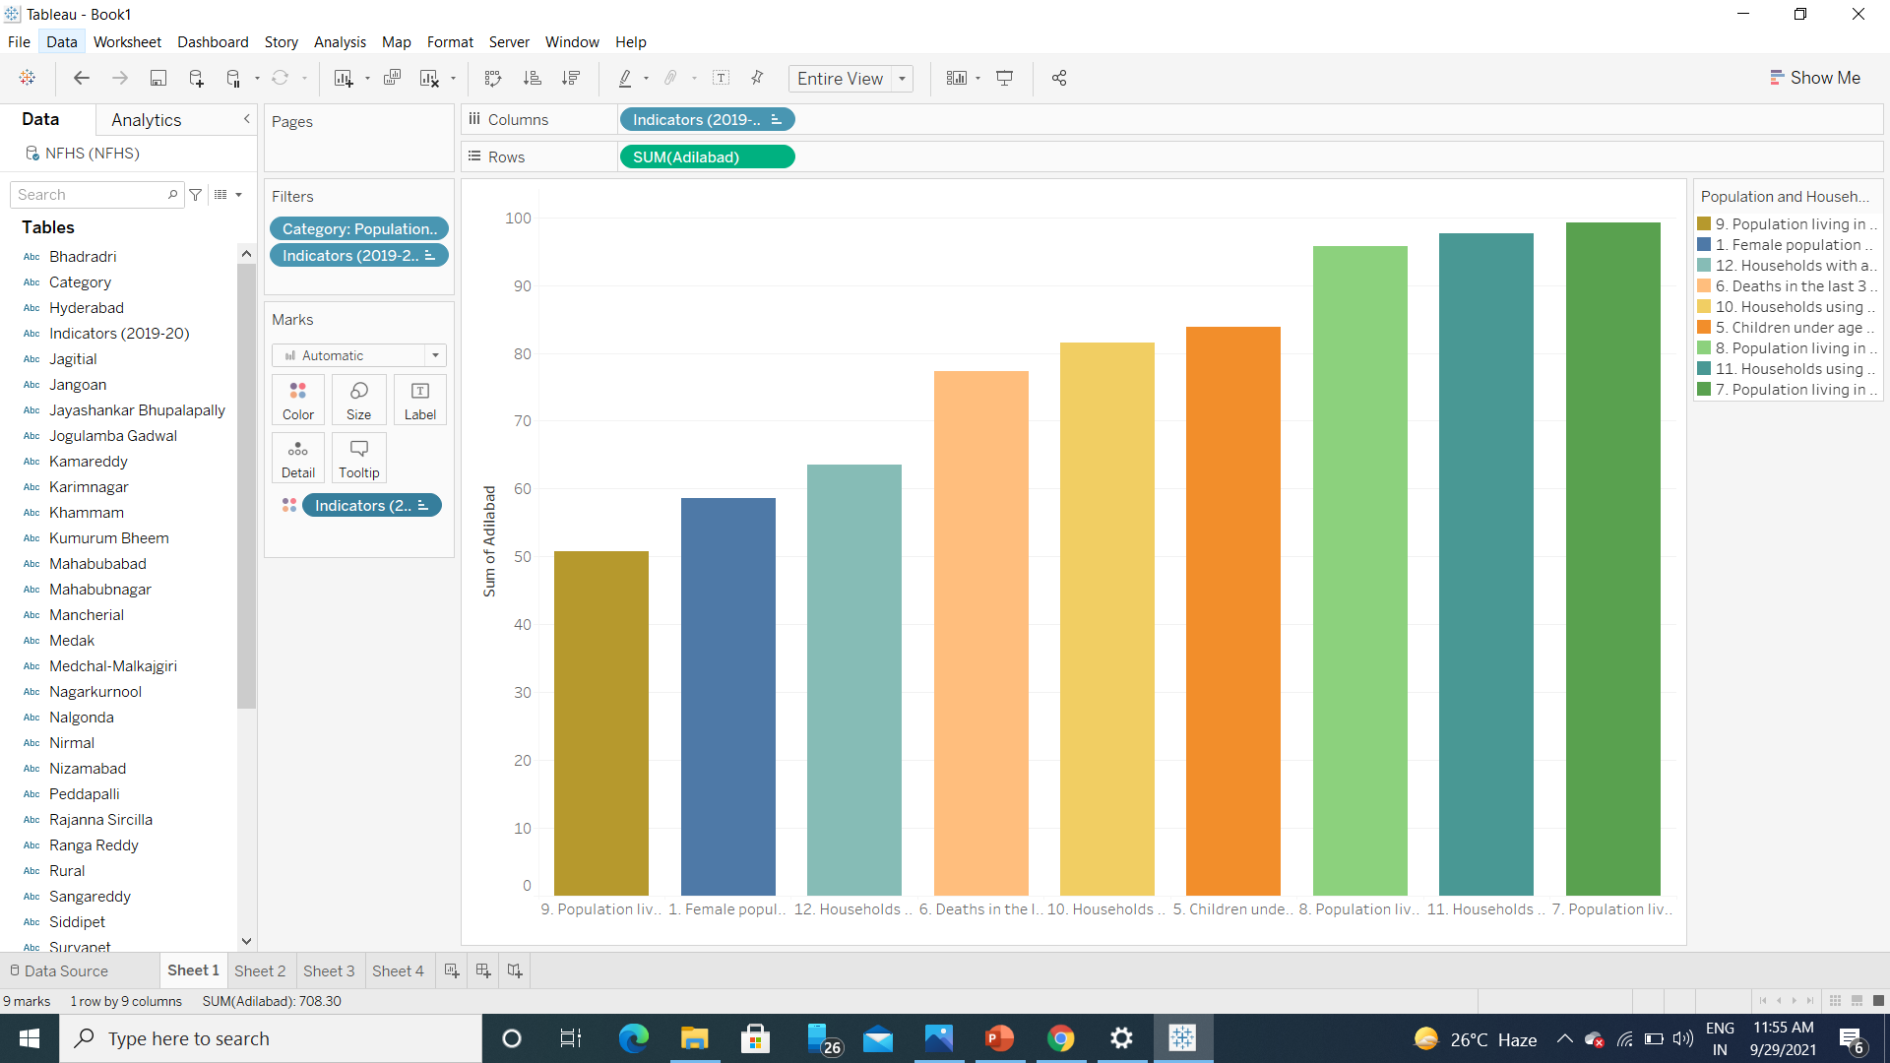
Conquering Women’s and Children’s Nutritional and Health
Disparities of District Adilabad(Telangana)
Ashutosh Pandey (Indian Institute of Technology (BHU) Varanasi)
Introduction
Analysis
Solution
The National Family Health Survey (NFHS) , provides information on population, health and nutrition for India and each State / Union territory. NFHS also provides district-level estimates for many important indicators.
Adilabad is north-most district of Telangana. On the basis of basic life amenities - such as electricity, registration of people is good.
The sanitation facilities and nutrition among children and women is not at par with other facilities.
On analyzing the health and nutritional condition it was found that the Anaemia is prevalent in women and women and children in district which indicate that the Health condition of women.
About 72% children between age 6-53 months are anaemic.
About 61% women between age 15-49 years are anaemic.
Only 9% percent of children between the age 6-23 months get adequate diet and about 52% children under 5 years are underweight.
After analyzing the NFHS data, status of women is poor in domain of nutrition and heath.
Spread awareness among people
by the means of radio,TV, social
media and newspaper about the
importance of nutrition in early
stage of life.
After seeing the status It seems that already running schemes and health workers are unable to do their work at grassroot level. there is need of weekly supervision of health worker so that they do their work properly.
Anganbadi and ASHA workers should be given charge of nutritional status of children below 5 years and proper monitering should be done to improve the nutrition condition of minor children.
Online record should be maintain for each minor children including all the vaccination and nutrition record of each children and higher official should have look into records and supervise accordingly.
Conclusion
Overall Adilabad has good electricity and other civic facilities . Nutritional and Health condition need improvement which can be improved by above mentioned solution.
Nutritional Condition of women and children
After analyzing the graph it can be concluded that nutrition and health condition of women are not good and there is need of improvement in this field.

